Slide 1
Introduction to Nanopore (ONT) sequencing
Rapid Response – Updated Sept 2026

Slide 2






ONT mNGS pipeline
Study design
xNA extraction
Library prep
Sequencing
Data analysis
Pathogen ID
INTRODUCTION

Slide 3
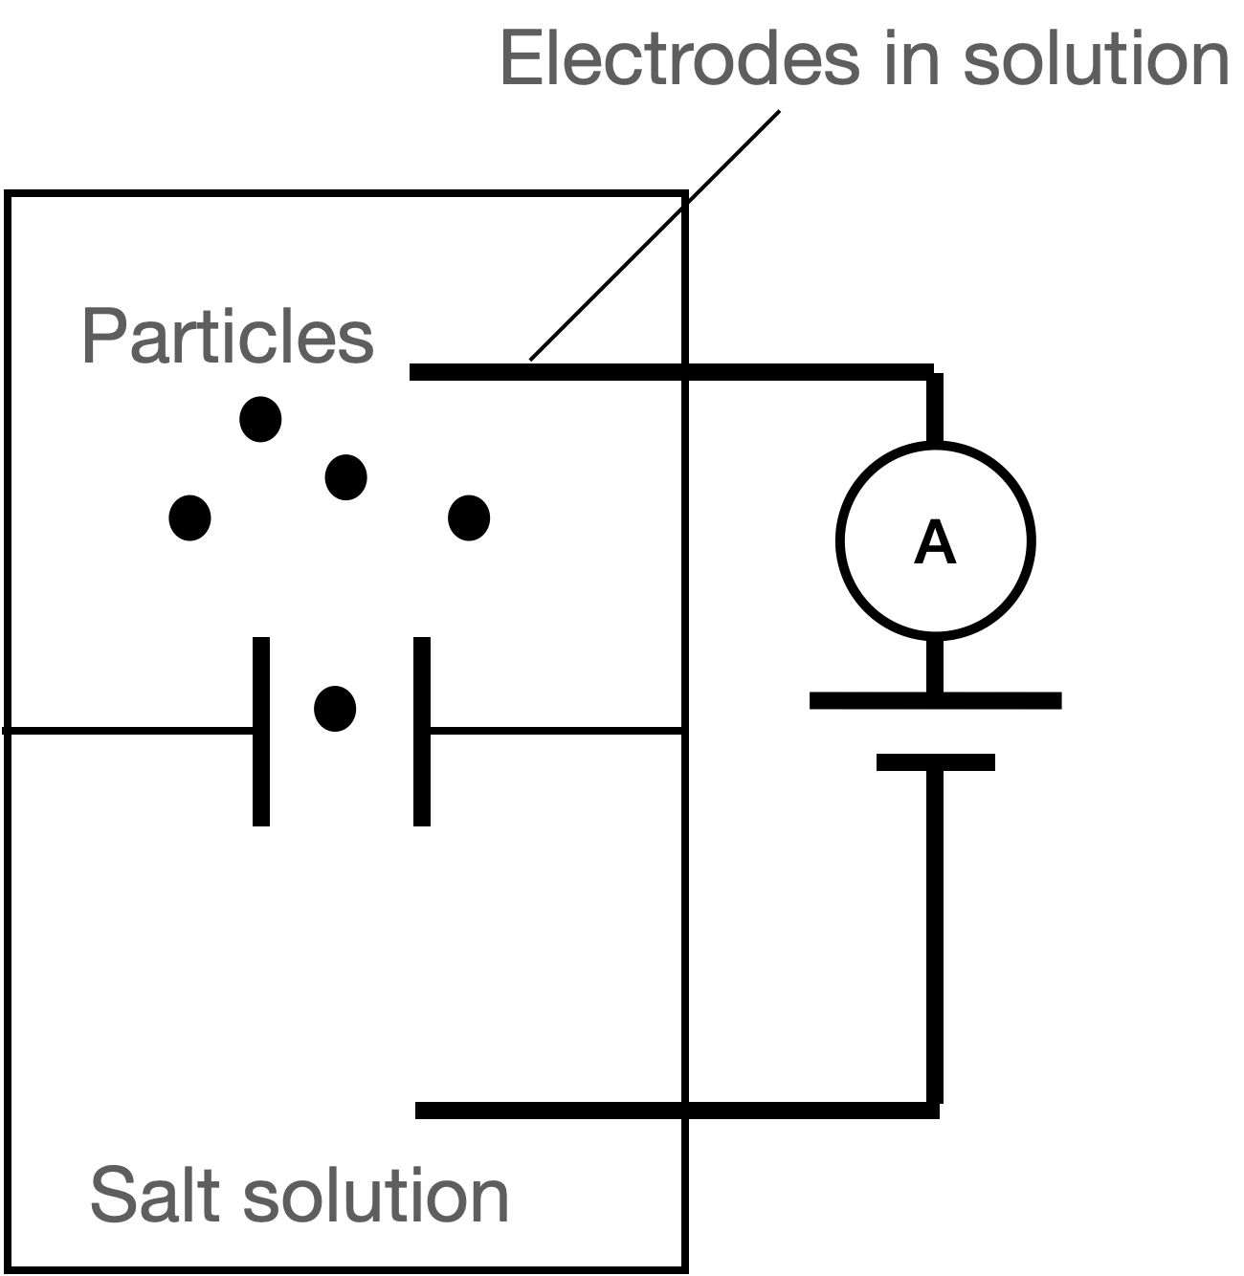
What is nanopore sequencing?
Use of nano-scale sensors to detect sequence of nucleotides
Sensors work by detecting changes in electrical current as DNA/RNA particles flow through a hole (“pore”)
ONT is one of two commercially available nanopore platforms (other is Qitan)

Slide 4
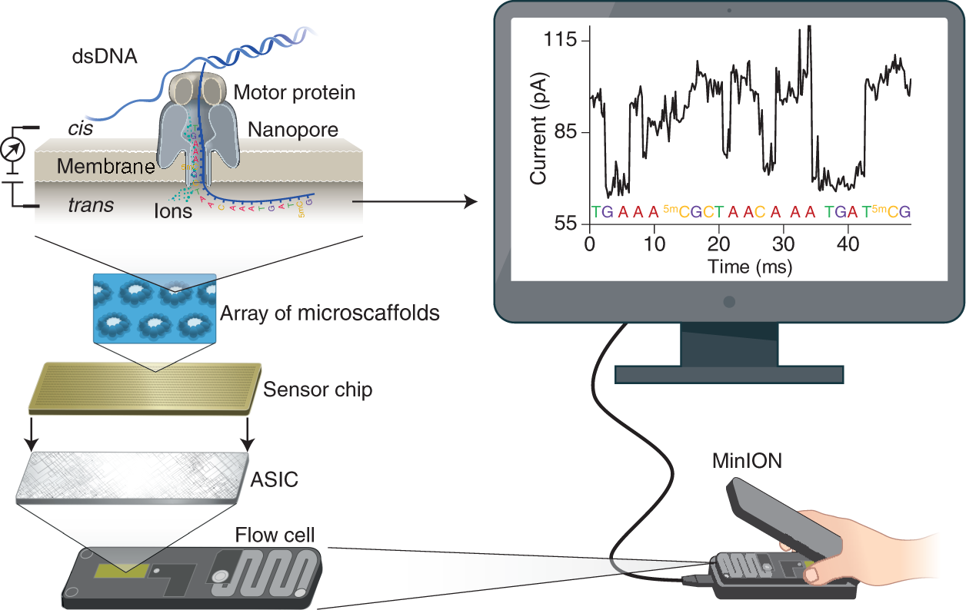
Principles of Oxford Nanopore sequencing

Slide 5
Principles of Oxford Nanopore sequencing
https://www.nature.com/articles/s41587-021-01108-x

Slide 6

Principles of Oxford Nanopore sequencing
Biological pores and motor proteins used to guide DNA/RNA across electrical gradient
Changes in electrical signal during this passage (due to blocking of electrons) detected electronically

Slide 7
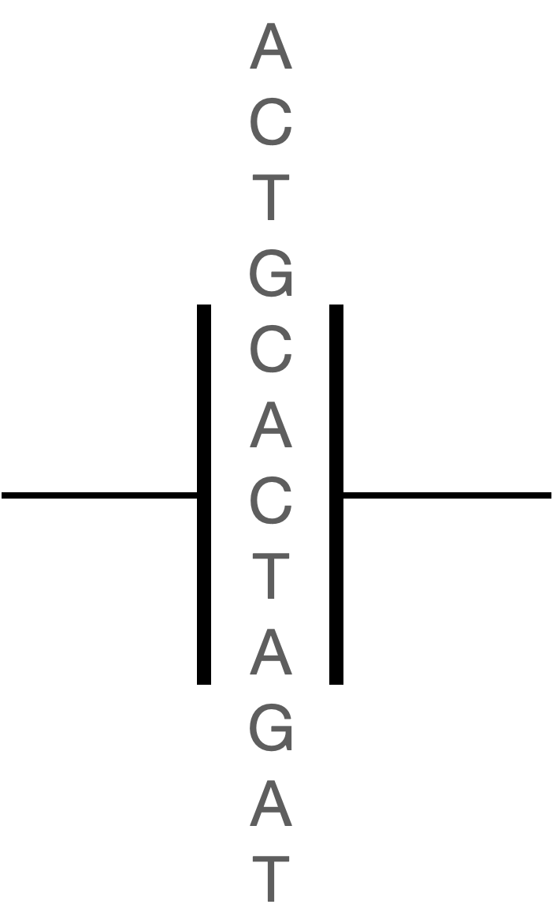
Principles of Oxford Nanopore sequencing
Size of the pore accommodates 5 nucleotides
DNA/RNA translocation typically happens at ~million bases/second, which is too fast
Translocation is slowed down to ~1000 bases/second in ONT to allow for discrimination of signals

Slide 8
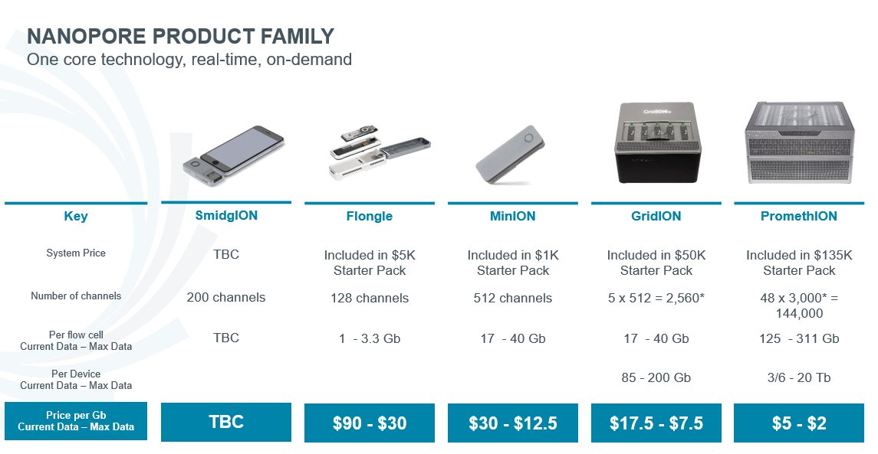
Different ONT instruments
Except for the GridION they are being dephased

Slide 9

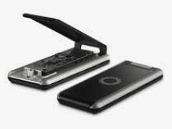
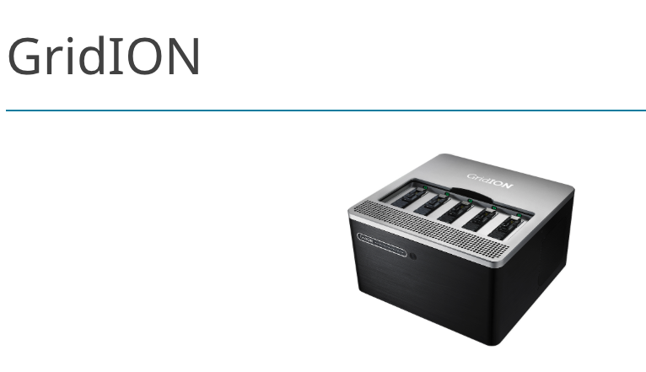
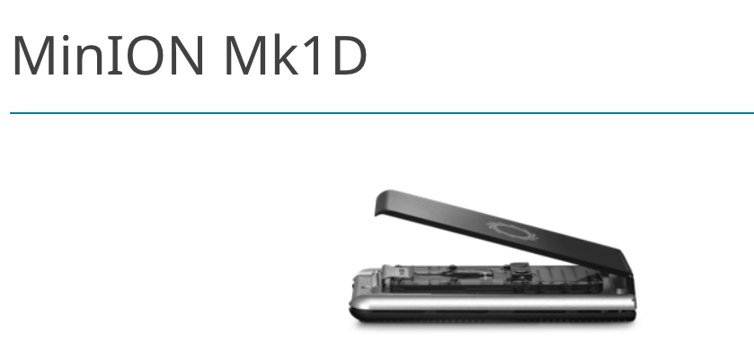
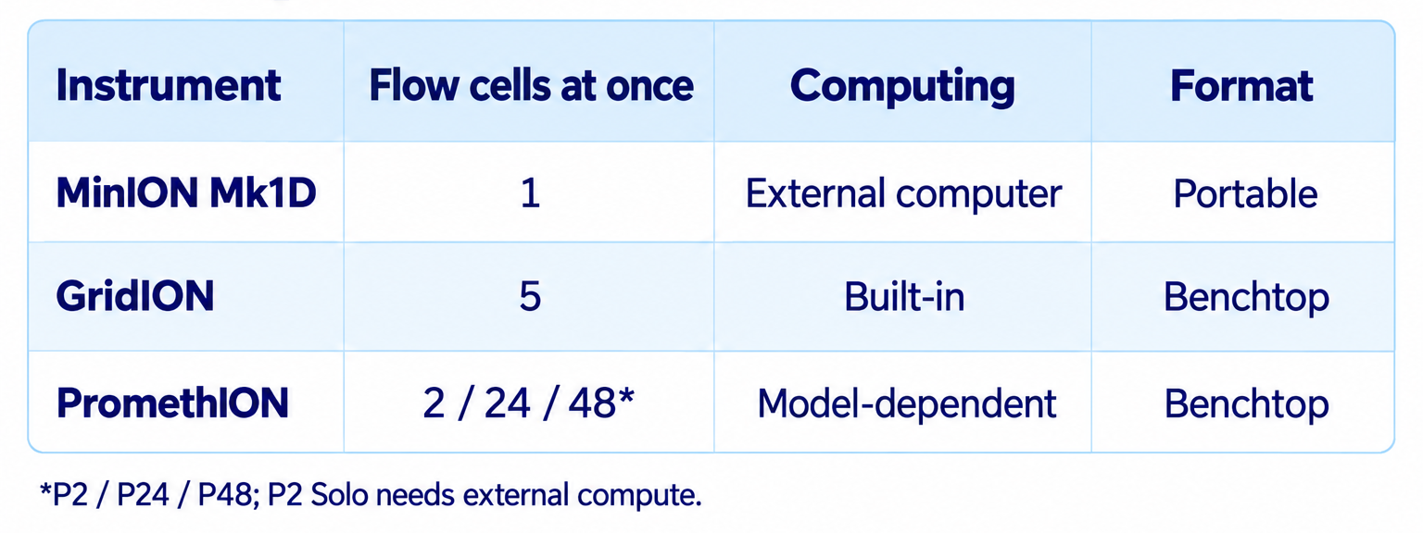
Different ONT instruments 2026
PromethION Series
Notes:
HT sequencing lowers costs and

Slide 10
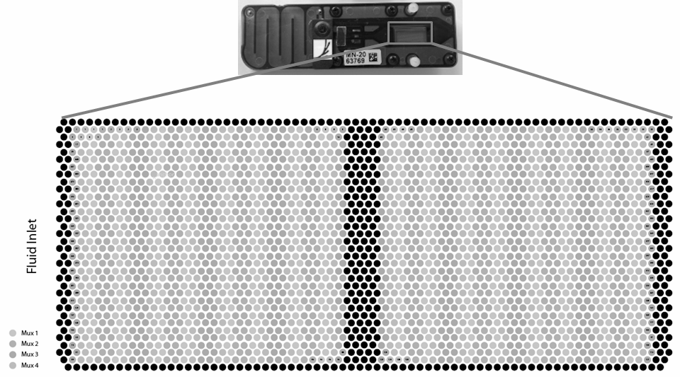
The MinION flow cell (see here for more)
Each flow cell has 2048 pores
Typically only ~1200-1600 are actually available on a new flow cell
Signal from 512 pores can be detected simultaneously

Slide 11
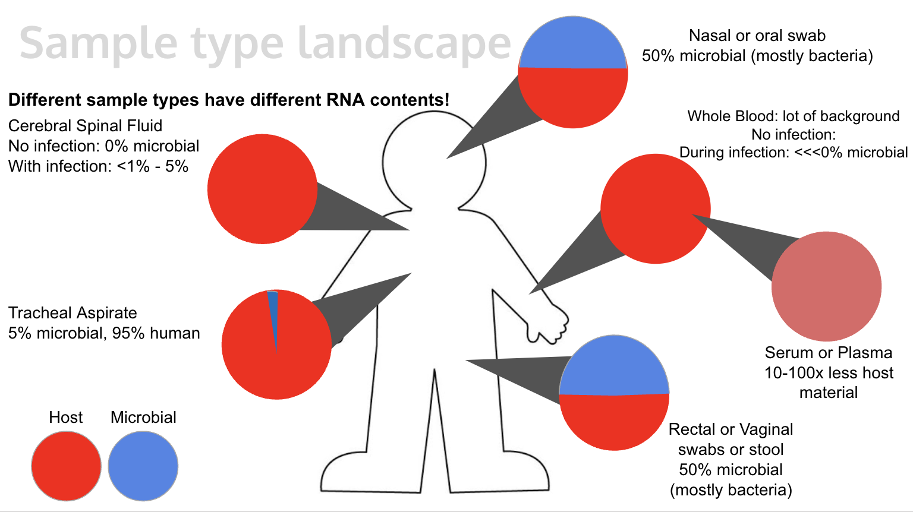
Considerations when doing metagenomics (mNGS)
DNA or RNA mNGS?
  Purpose of study
  Pathogen landscape
Sample type
  Total nucleic acid abundance
  Proportion of host vs. microbe

Slide 12
Considerations when doing Nanopore (ONT) sequencing
Sample integrity
  Important to ensure high quality with little to no degradation
  True for Illumina as well, but even more so for ONT
Library preparation kit (link to available kits)
DNA or RNA?
PCR or PCR-free?
Multiplexing or single sample?

Slide 13
Considerations when doing Nanopore (ONT) sequencing
Sample integrity
  Important to ensure high quality with little to no degradation
  True for Illumina as well, but even more so for ONT
Library preparation kit (link to available kits)
  DNA or RNA?
  PCR or PCR-free?
  Multiplexing or single sample?
Current kit of choice: Rapid PCR barcoding kit (SQK-RPB114.24)

